Slide 1














Major Project
Fit-Me
Presented by
Lakshay Yadav 21csu342
Disha Taneja 21csu391
Geet Khanna 21csu346
Ishita Bindal 21csu493
Sanchit Bajaj 21csu305

Slide 2
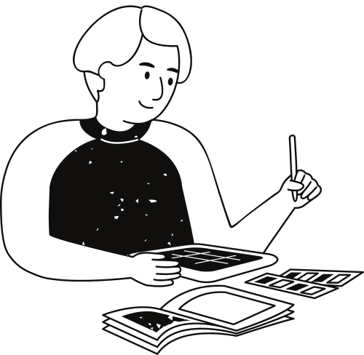
Definition of Done (DoDs)
Create an app for tracking health and wellness activities such as exercise, nutrition, and mental health.
Implement features for logging workouts, meals, water intake, mood, etc.
Utilize a bottom navigation bar for easy access to different health categories.
Use stateless widgets to display health data and progress charts.
Implement input form widgets for recording health activities and goals.

Slide 3
About
Fit-Me
Introducing Fit-Me: Your all-in-one health companion. Track fitness goals, monitor nutrition, and manage stress with ease. Personalized workouts, meditation sessions, and meal plans tailored to your needs. Stay motivated, improve sleep, and boost overall well-being. Your path to a healthier lifestyle starts here. Download Fit-Me now.

Slide 4
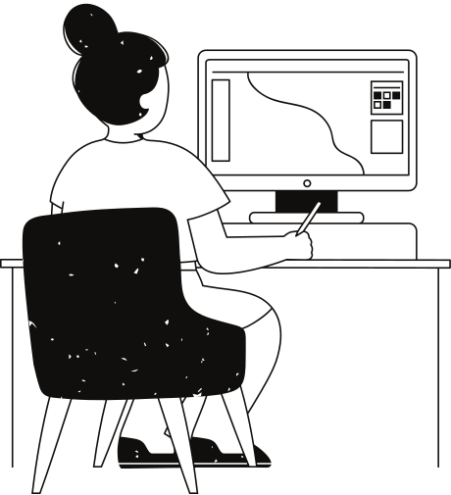
Features
Keep a track of your progress.
Muliple categories helps to bring clarity.
AI support and chatbox.
Personalized workout plans.
Customizable workout plans.
Regular checkup tracking.

Slide 5
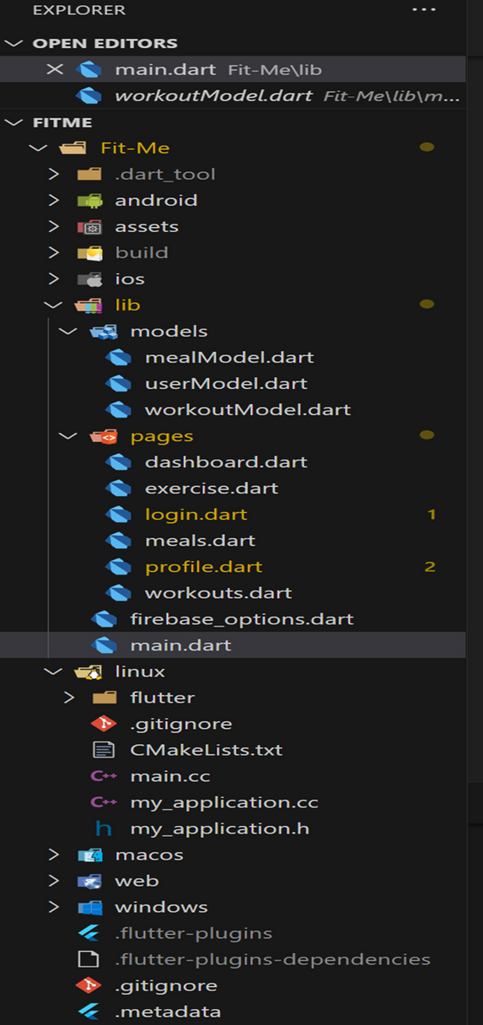
Project Structure
Main components:
Models:
mealModel.dart
userModel.dart
workoutModel.dart
Pages:
dashboard.dart
exercise.dart
login.dart
meals.dart
profile.dart
workouts.dart
main.dart
firebase_options.dart

Slide 6
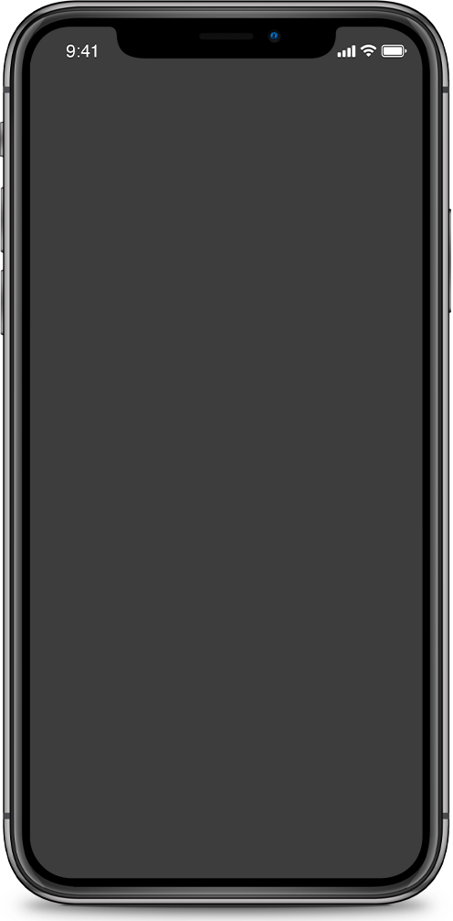
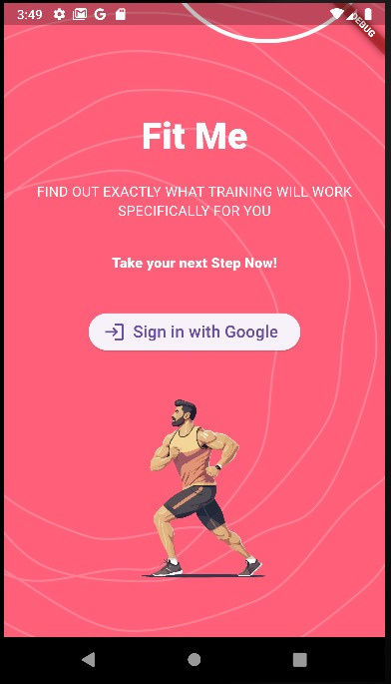
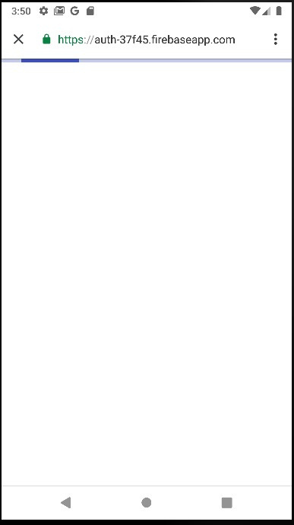
Prototype & Design

Slide 7
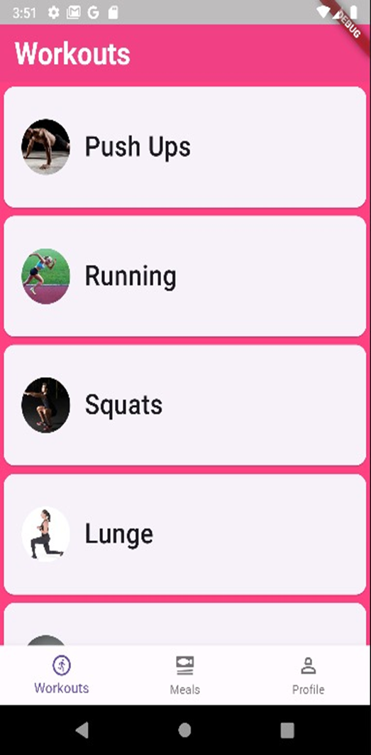
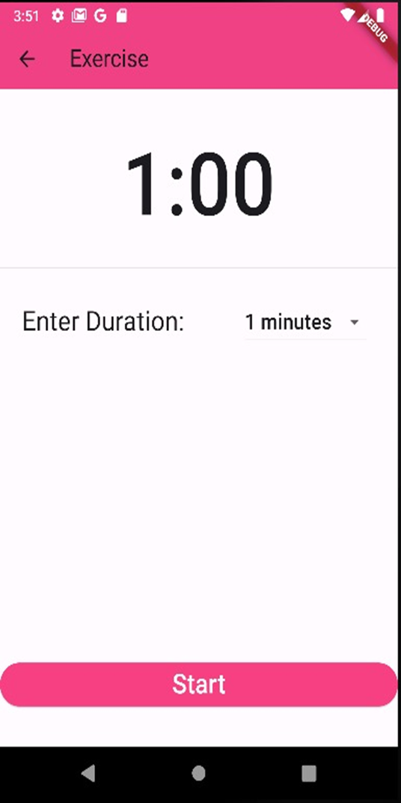
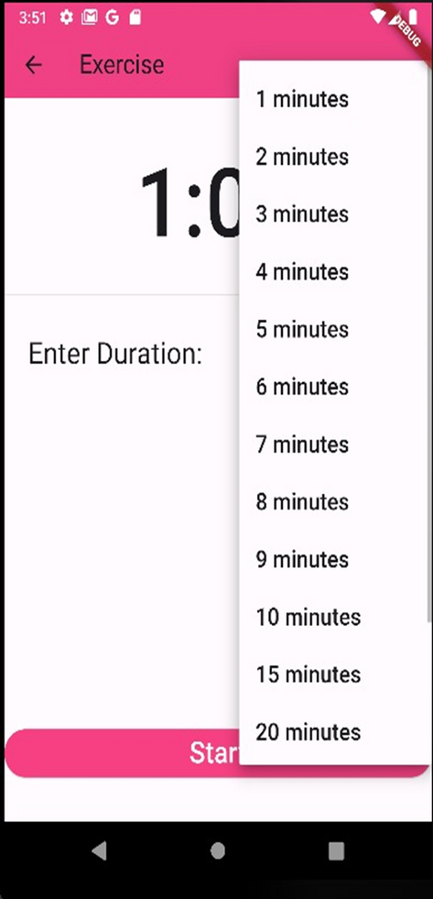

Slide 8
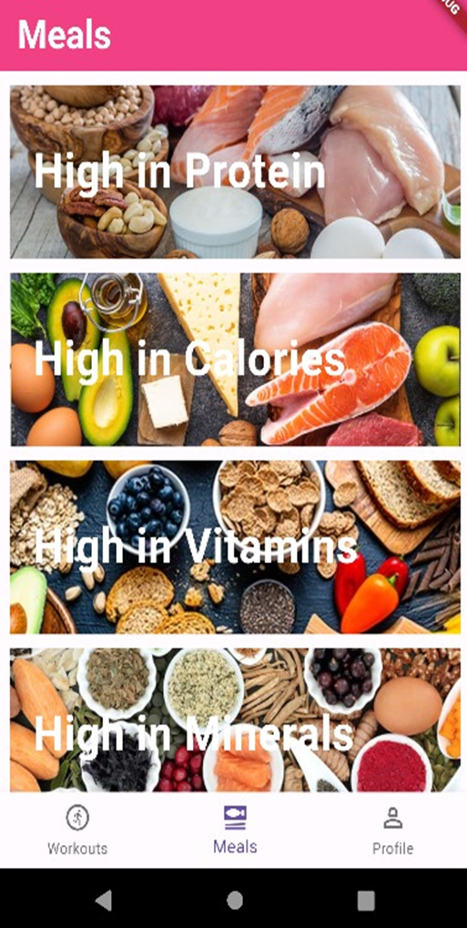
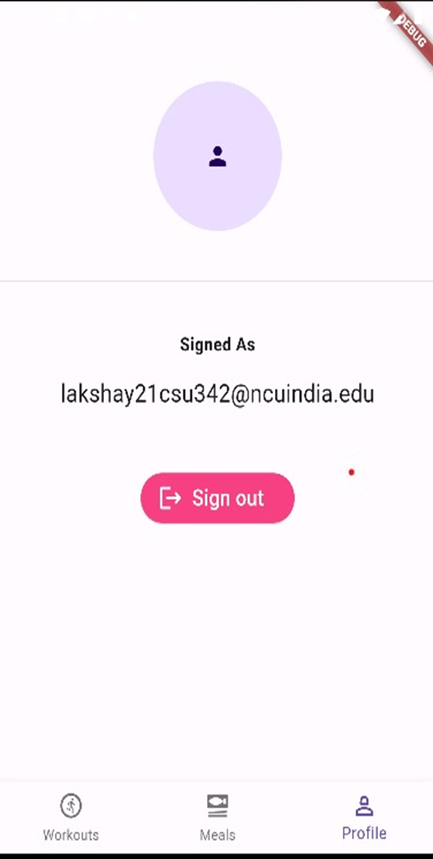

Slide 9
Upcoming
Versions
V-1.0
V-2.0
V-3.0
V-4.0
Contains workout plans and different categories
Support for regular checkups and tracking
Easy customizable and personalized workout plans
AI Support for increasing efficiency

Slide 10
Upcoming Features
Fit-Me is a health well being application and in its further versions we tend to introduce the AI support and chatbox for enabling much more accuracy of advices and exercises with routine checkups and tracking. Further more we aim to bring features for personalized and customized workouts that suits your day to day routine.
Fit-Me also aims to provide medical and emergency support for the old age people.

Slide 11
Thank You
Everyone!

